Slide 1
JavaScript & API’s
Creativity & Computation Lab
Week 3

Slide 2
APIs
Application Program Interface
Is a set of routines, protocols, tools for building software application
In practice, most often an API is a library that includes specifications for routines, data structures, object classes,and variables.

Slide 3
APIs on the web
On the web, an API is a way for your code to get information from a third-party.
You send hypertext transfer protocol (HTTP) requests.

Slide 4
APIs
The API returns JSON or XML files.
You can use AJAX to parse through information (as JSON objects) found in APIS.
ex. of API url:
http://api.wunderground.com/api/personalKey/features/settings/q/query.format

Slide 5
What is JSON?
Javascript Object Notation Is a lightweight data-interchange format. It is easy to read and write as well as easy for machines to parse and generate.

Slide 6
What is JSON?
var teacher = {
“firstName” : “Sven”,
“lastName” : “Travis”,
“job” : “Professor”,
“degree” : “MFA”
};

Slide 7
What is XML?
Extensible Markup Language
Is file format used to create common information formats and share both the format and the data for web and elsewhere

Slide 8
What is XML?
<teacher>
<firstName> Sven </firstname>
<lastName>Travis</lastname>
<job>Professor</job>
<degree>MFA</degree>
</teacher>

Slide 9
Lets try it
Let’s get started
But first…you need an API key.
Go to www.wunderground.com/weather/api/

Slide 10
Homework:
Pick an API and grab data from it.
Use that data to create a data visualization

Slide 11
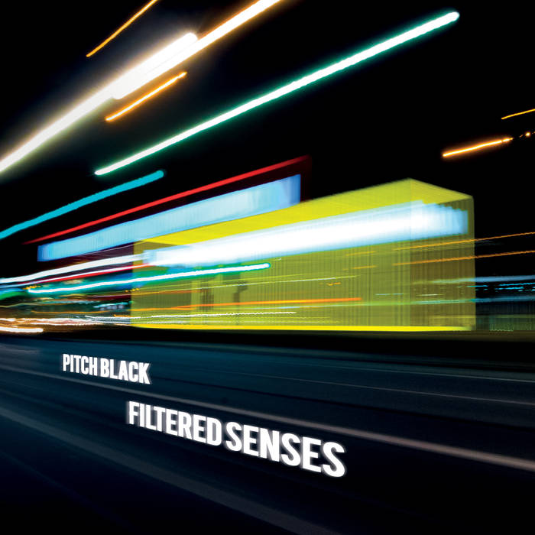
Album of the week:
Filtered Senses by Pitch Black
http://pitchblack.bandcamp.com/

